Slide 1

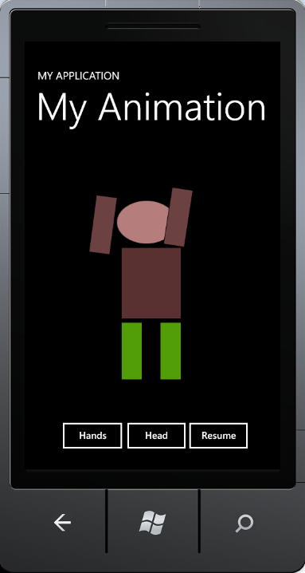
Lecture 26 Silverlight and Mobile Apps Development
CSE 445 / 598
Distributed Software Development
Yinong Chen

Slide 2
Lecture Outline
Silverlight Overview
Getting Started with Hello Phone application
Creating Animations in Phone Apps
Calling Web services in Phone Apps
Encryption/Decryption Service
Weather Service
Complex applications

Slide 3
Visual Studio Development Environment
Desktop Software Development
Web Software Development
Workflow Foundation
WPF:
Windows Presentation Foundation
ASP .Net Web Site
JavaScript, AJAX
HTML, CSS, XSL
ASP .Net Windows Forms Applications
Silverlight Constructs
Silverlight Applications
Windows Communication Foundation
GDI+
DLL and components
Framework Class Library
User controls
Server controls
Common Language Runtime

Slide 4
Silverlight Components / Controls
Getting Started: http://www.silverlight.net/learn/overview/what-is-silverlight
Common controls:
Textbox, Checkbox, RadioButton, ComboBox, …
TabControl, ScrollViewer, ProgressBar, SpeedBar, …
Extensible control base classes
Layout controls:
Grid, StackPanel
Data controls:
DataGrid, TexBlock, etc.
Data:
2-way data binding
More LINQ support: LINQ to XML
Grid
StackPanel
TextBlock
TextBlock
TextBlock

Slide 5
Silverlight Animation
In addition to the dynamic Graphic classes, Silverlight also supports animation of objects of animation classes.
Linear interpretation: The object moves smoothly from point A to point B
DoubleAnimation
PointAnimation
ColorAnimation
Key-frame animation: Object jump from point A to point B
DoubleAnimationUsingKeyFrames
PointAnimationKeyUsingFrames
ColorAnimationUsingKeyFrames
ObjectAnimationUsingKeyFrames
Each animation can be implemented (coded)
in XAML or
in C# code behind XAML

Slide 6
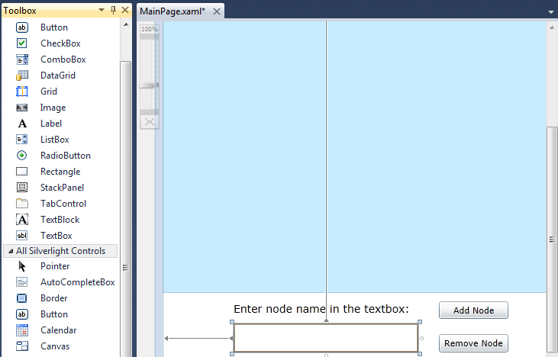
Creating a Silverlight Application Example
MainPage.xaml: Creating the GUI:
A canvas for dynamic objects to move around
Other I/O controls, e.g., textboxes, buttons, and labels

Slide 7
Code behind MainPage: MainPage.xaml.cs
namespace LinkedList {
public partial class MainPage : UserControl {
private MasterList list;
public MainPage() {
InitializeComponent(); list = new MasterList(mainSpace);
}
private void addButton_Click(object sender, RoutedEventArgs e) {
list.addLast(textBox.Text); textBox.Text = "";
}
private void removeButton_Click(object sender, RoutedEventArgs e) {
list.remove(textBox.Text); textBox.Text = "";
}
private void entercapture(object sender, KeyEventArgs e) {
if (e.Key == Key.Enter) {
list.addLast(textBox.Text); textBox.Text = "";
}
}
}
If Enter key is pressed

Slide 8
Code behind MainPage: MainPage.xaml.cs
public void animateLastAdd() {
DoubleAnimation upperAnimation = new DoubleAnimation();
DoubleAnimation lowerAnimation = new DoubleAnimation();
DoubleAnimation nullAnimation = new DoubleAnimation();
DoubleAnimation valueAnimation = new DoubleAnimation();
Duration duration = new Duration(TimeSpan.FromSeconds(1.5));
upperAnimation.Duration = duration; lowerAnimation.Duration = duration;
valueAnimation.Duration = duration; nullAnimation.Duration = duration;
Storyboard story = new Storyboard(); story.Duration = duration;
story.Children.Add(lowerAnimation); story.Children.Add(upperAnimation);
story.Children.Add(nullAnimation); story.Children.Add(valueAnimation);
Storyboard.SetTargetProperty(upperAnimation, new PropertyPath("(Canvas.Top)"));
Storyboard.SetTargetProperty(lowerAnimation, new PropertyPath("(Canvas.Top)"));
Storyboard.SetTargetProperty(nullAnimation, new PropertyPath("(Canvas.Top)"));
Storyboard.SetTargetProperty(valueAnimation, new PropertyPath("(Canvas.Top)"));
Storyboard.SetTarget(upperAnimation, upperBox); upperAnimation.To = 70;
Storyboard.SetTarget(valueAnimation, valueLabel); valueAnimation.To = 70;
Storyboard.SetTarget(lowerAnimation, lowerBox); lowerAnimation.To = 100;
Storyboard.SetTarget(nullAnimation, nullLabel); nullAnimation.To = 100;
story.Begin(); }

Slide 9
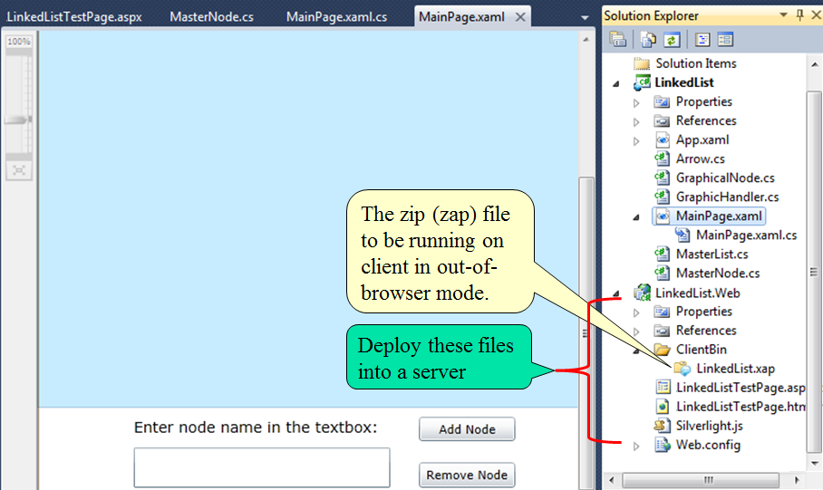
Silverlight App Deployment

Slide 10
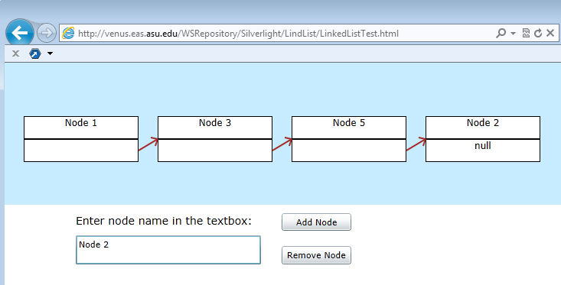
Silverlight App Test
http://venus.eas.asu.edu/WSRepository/Silverlight/LindList/LinkedListTest.html
http://www.public.asu.edu/~ychen10/projects/LinkedList/

Slide 11
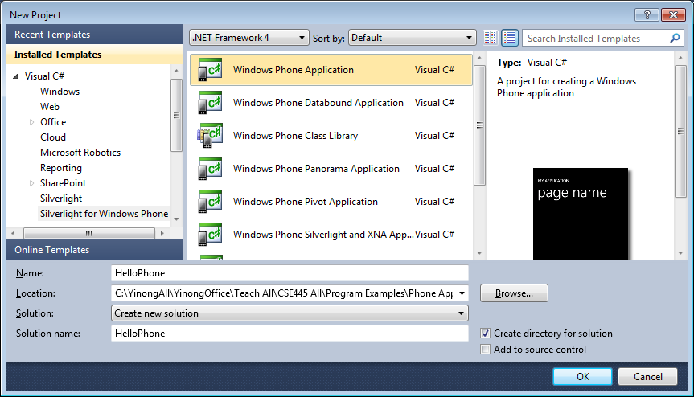
Preparation for Phone App Development
Start from: http://dev.windowsphone.com/en-us/home
GET SDK: Download the latest SDK package
Install SDK, start Visual Studio, & choose template

Slide 12
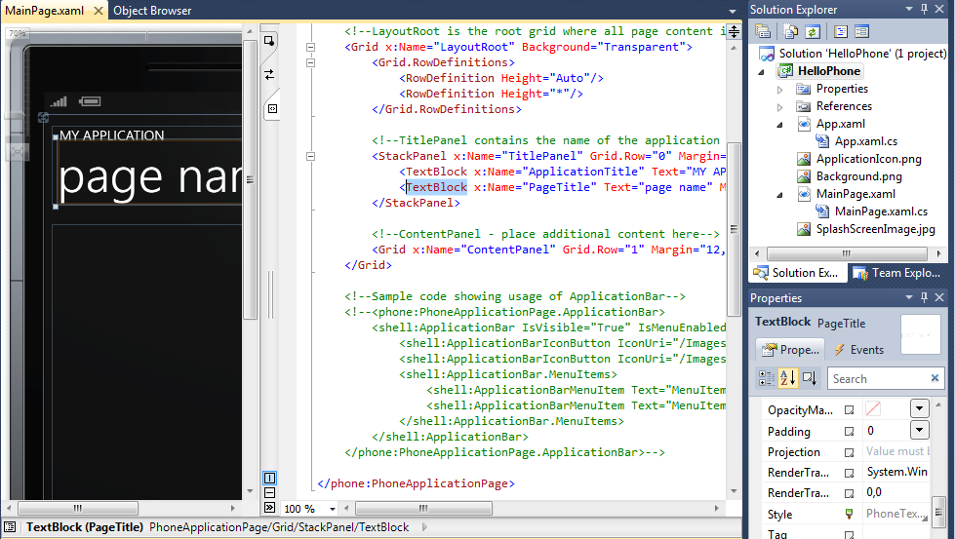
Main Page XAML View for GUI Design

Slide 13
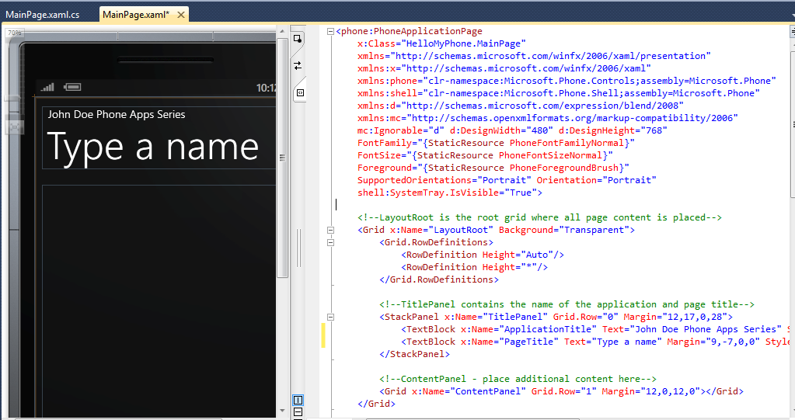
Change the TextBlock Text

Slide 14
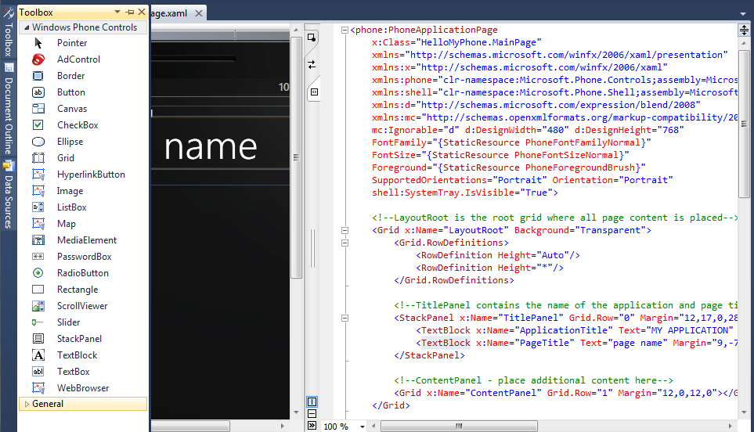
Using XAML & Toolbox for GUI Design

Slide 15
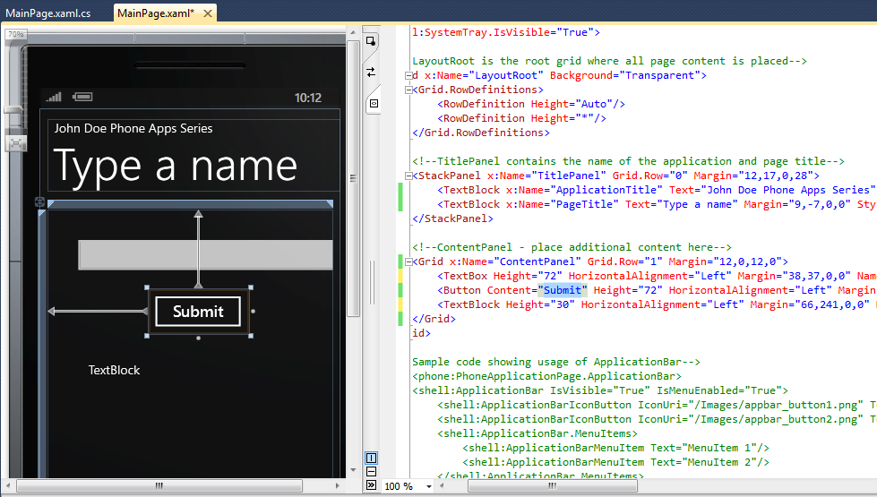
Add a Textbox, a Button, and a TextBlock

Slide 16
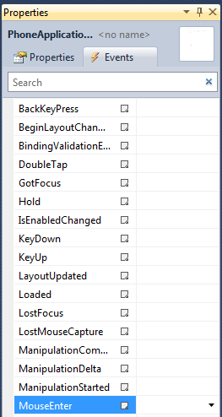
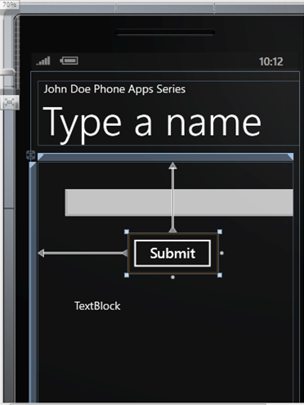
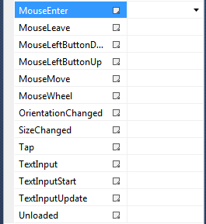
Define Events behind Textbox and Button
You can define different events to associate with different user inputs

Slide 17
XAML Code of the GUI Design
<Grid x:Name="LayoutRoot" Background="Transparent">
<Grid.RowDefinitions>
<RowDefinition Height="Auto"/>
<RowDefinition Height="*"/>
</Grid.RowDefinitions>
<!--TitlePanel contains the name of the application and page title-->
<StackPanel x:Name="TitlePanel" Grid.Row="0" Margin="12,17,0,28">
<TextBlock x:Name="ApplicationTitle" Text="John Doe Phone Apps Series" Style="{StaticResource PhoneTextNormalStyle}"/>
<TextBlock x:Name="PageTitle" Text="Type a name" Margin="9,-7,0,0" Style="{StaticResource PhoneTextTitle1Style}"/>
</StackPanel>
<!--ContentPanel - place additional content here-->
<Grid x:Name="ContentPanel" Grid.Row="1" Margin="12,0,12,0">
<TextBox Height="72" HorizontalAlignment="Left" Margin="38,37,0,0" Name="txtName" Text="" VerticalAlignment="Top" Width="460" />
<Button Content="Submit" Height="72" HorizontalAlignment="Left" Margin="161,127,0,0" Name="btnSubmit" VerticalAlignment="Top" Width="160" Click="btnSubmit_Click" />
<TextBlock Height="30" HorizontalAlignment="Left" Margin="66,241,0,0" Name="tbkDisplay" Text="TextBlock" VerticalAlignment="Top" />
</Grid>
</Grid>
namespace HelloMyPhone
{
public partial class MainPage : PhoneApplicationPage
{
// Constructor
public MainPage()
{
InitializeComponent();
}
private void btnSubmit_Click(object sender, RoutedEventArgs e)
{
tbkDisplay.Text = "Hello " + txtName.Text + ", how are you today?";
}
}
}
Code behind the GUI page

Slide 18
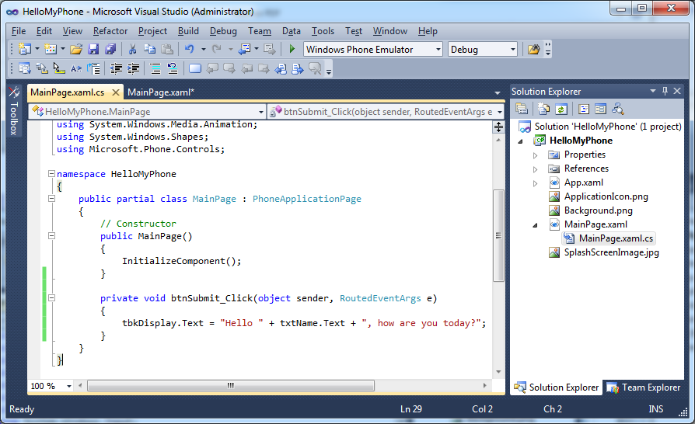
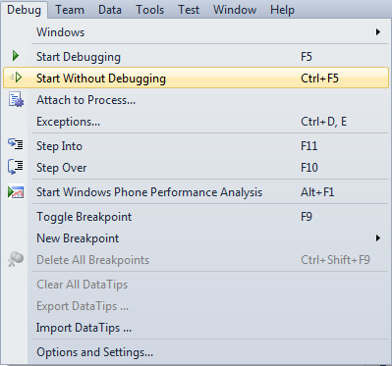
Main Page C# View for Programming

Slide 19
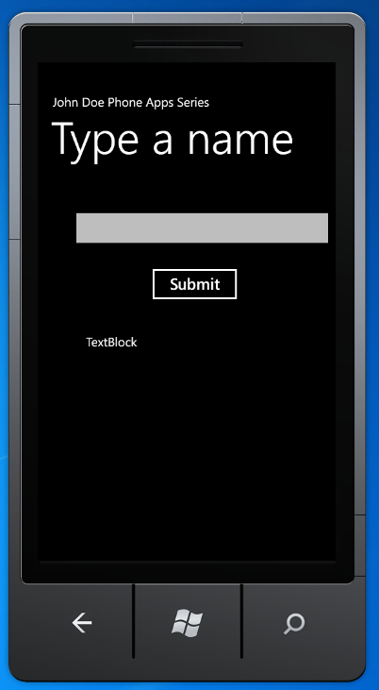
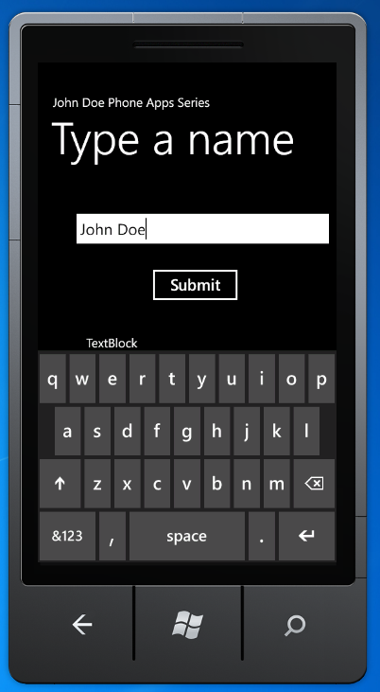
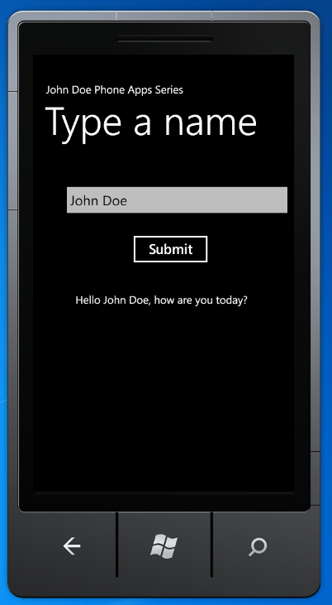
Start the Program in the Emulator

Slide 20
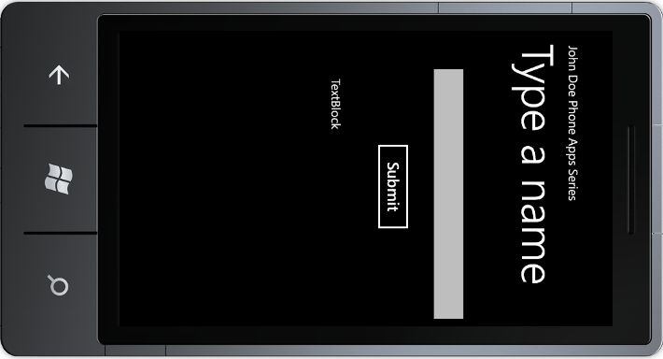
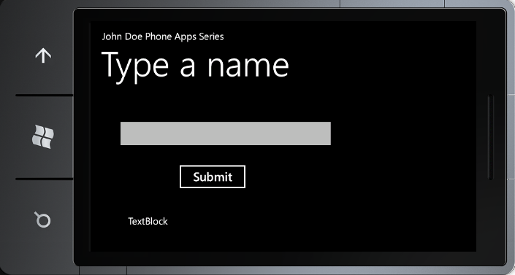

Orientation
Rotate your Phone, the GUI does not turn

Slide 21
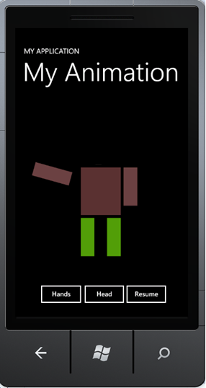
Steps of Creating Animation (1)
Selecting an object
Adding TranslateTransform elements
<Ellipse Name="ellipse1" Height="82" HorizontalAlignment="Left" Margin="169,104,0,0" Stroke="Black" StrokeThickness="1" VerticalAlignment="Top" Width="113" Fill="#FFB17F7F">
<Ellipse.RenderTransform>
<TranslateTransform x:Name="headMove" />
</Ellipse.RenderTransform>
</Ellipse>
<Rectangle Fill="#FF6C4040" Height="108" HorizontalAlignment="Left" Margin="148,206,0,0" Name="rectangle3" Stroke="Black" StrokeThickness="1" VerticalAlignment="Top" Width="40">
<Rectangle.RenderTransform>
<RotateTransform x:Name="rotate1" />
</Rectangle.RenderTransform>
</Rectangle>
Ellipse
To be defined in Storyboard
Rectangle
To be defined in C# program

Slide 22
Steps of Creating Animation (2)
Define a reference of Storyboard object. We use:
Storyboard.Begin();
Storyboard.Pause();
to mange the object.
Adding Storyboard using animation classes
<phone:PhoneApplicationPage.Resources>
<Storyboard x:Name="headStoryboard">
<DoubleAnimation Storyboard.TargetName="headMove"
Storyboard.TargetProperty="X"
From="-10" To="10" Duration="0:0:0.50"
AutoReverse="True"
RepeatBehavior="Forever" />
<DoubleAnimation Storyboard.TargetName="legMove"
Storyboard.TargetProperty="Y"
From="-5" To="5" Duration="0:0:0.50"
AutoReverse="True"
RepeatBehavior="Forever" />
</Storyboard>
</phone:PhoneApplicationPage.Resources>
Start or Pause the storyboad
headStoryboard.Begin(); headStoryboard.Pause();
Define an operation in the object. We can define multiple operations in the object.
Define an operation in the object. We can define multiple operations in the object.

Slide 23
Put in a User Control in a Web Application if we are developing a Web app
<UserControl x:Class="SilverlightTranslateTransformAnimation.MainPage" xmlns="http://schemas.microsoft.com/winfx/2006/xaml/presentation" xmlns:x="http://schemas.microsoft.com/winfx/2006/xaml" <Canvas Height="200" Width="200" Background="White"> <Canvas.Resources> <Storyboard x:Name="headStoryboard">
<DoubleAnimation Storyboard.TargetName="headMove"
Storyboard.TargetProperty="X"
From="-10" To="10" Duration="0:0:0.50“ AutoReverse="True"
RepeatBehavior="Forever" />
</Storyboard>
</Canvas.Resources>
<Ellipse Name="ellipse1" Height="82" HorizontalAlignment="Left"
Margin="169,104,0,0" Stroke="Black" StrokeThickness="1" VerticalAlignment="Top" Width="113" Fill="#FFB17F7F">
<Ellipse.RenderTransform>
<TranslateTransform x:Name="headMove" />
</Ellipse.RenderTransform>
</Ellipse>
</Canvas>
</UserControl>

Slide 24
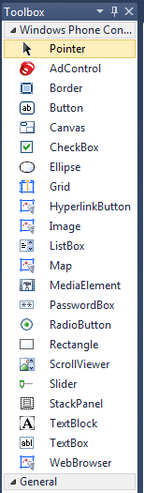
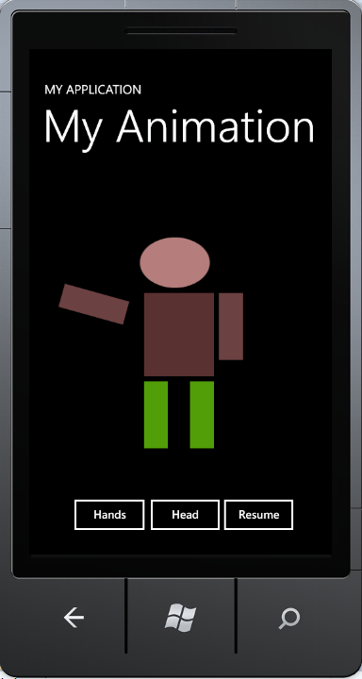
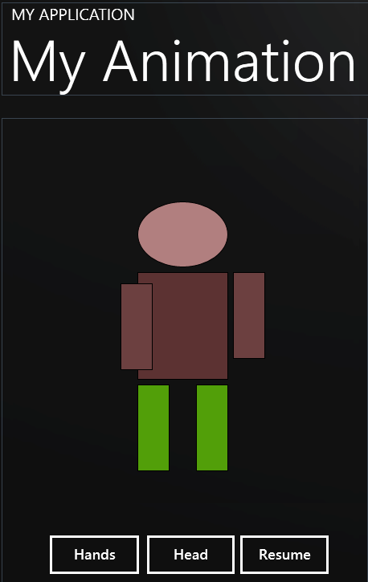
Put it in a Phone Application
Start a new phone project “MyPhoneAnimation”

Slide 25
XAML Defining the GUI (Part 1: MainPage.xaml)
Namespace generated by the template
<phone:PhoneApplicationPage
x:Class="MyPhoneAnimation.MainPage"
xmlns="http://schemas.microsoft.com/winfx/2006/xaml/presentation"
xmlns:x="http://schemas.microsoft.com/winfx/2006/xaml"
xmlns:phone="clr-namespace:Microsoft.Phone.Controls;assembly=Microsoft.Phone"
xmlns:shell="clr-namespace:Microsoft.Phone.Shell;assembly=Microsoft.Phone"
xmlns:d="http://schemas.microsoft.com/expression/blend/2008"
xmlns:mc="http://schemas.openxmlformats.org/markup-compatibility/2006"
mc:Ignorable="d" d:DesignWidth="480" d:DesignHeight="768"
FontFamily="{StaticResource PhoneFontFamilyNormal}"
FontSize="{StaticResource PhoneFontSizeNormal}"
Foreground="{StaticResource PhoneForegroundBrush}"
SupportedOrientations="PortraitOrLandscape" Orientation="Portrait"
shell:SystemTray.IsVisible="True">

Slide 26
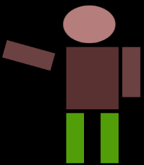
XAML Defining (Part 2: Storyboard)
Program your animation in XAML using Storyboard
<phone:PhoneApplicationPage.Resources>
<Storyboard x:Name="headStoryboard">
<DoubleAnimation Storyboard.TargetName="headMove"
Storyboard.TargetProperty="X"
From="-10" To="10" Duration="0:0:0.50"
AutoReverse="True"
RepeatBehavior="Forever" />
<DoubleAnimation Storyboard.TargetName="legMove"
Storyboard.TargetProperty="Y"
From="-5" To="5" Duration="0:0:0.50"
AutoReverse="True"
RepeatBehavior="Forever" />
</Storyboard>
</phone:PhoneApplicationPage.Resources>
It defines two operations: the head and leg movements
It defines two operations: the head and leg movements

Slide 27
XAML Defining (Part 3: Root Grid)
<!-- LayoutRoot is the root grid where all page content is placed-->
<Grid x:Name="LayoutRoot" Background="Transparent">
<Grid.RowDefinitions>
<RowDefinition Height="Auto"/>
<RowDefinition Height="*"/>
</Grid.RowDefinitions>
<!--TitlePanel contains the name of the application and page title-->
<StackPanel x:Name="TitlePanel" Grid.Row="0" Margin="12,17,0,28">
<TextBlock x:Name="ApplicationTitle" Text="MY APPLICATION" Style="{StaticResource PhoneTextNormalStyle}"/>
<TextBlock x:Name="PageTitle" Text="My Animation" Margin="9,-7,0,0" Style="{StaticResource PhoneTextTitle1Style}"/>
</StackPanel>
Generated by the template based on the drawing.

Slide 28
XAML Defining (Part 4: Animation Object Head)
<!--ContentPanel - place additional content here-->
<Grid x:Name="ContentPanel" Grid.Row="1" Margin="12,0,12,0">
<Ellipse Name="ellipse1" Height="82" HorizontalAlignment="Left" Margin="169,104,0,0" Stroke="Black" StrokeThickness="1" VerticalAlignment="Top" Width="113" Fill="#FFB17F7F">
<Ellipse.RenderTransform>
<TranslateTransform x:Name="headMove" />
</Ellipse.RenderTransform>
</Ellipse>
<Rectangle Height="134" HorizontalAlignment="Left" Margin="169,192,0,0" Name="rectangle2" Stroke="Black" StrokeThickness="1" VerticalAlignment="Top" Width="113“ Fill="#FF5C3232" />
<Rectangle Fill="#FF6C4040" Height="108" HorizontalAlignment="Left" Margin="148,206,0,0" Name="rectangle3" Stroke="Black" StrokeThickness="1" VerticalAlignment="Top" Width="40">
<Rectangle.RenderTransform>
<RotateTransform x:Name="rotate1" />
</Rectangle.RenderTransform>
</Rectangle>
Define the head
Define the body
Define the right arm. Code in C#

Slide 29
XAML Defining (Part 4: Animation Objects Arms)
<Rectangle Fill="#FF6C4040" Height="108" HorizontalAlignment="Left" Margin="288,192,0,0" Name="rectangle4" Stroke="Black" StrokeThickness="1" VerticalAlignment="Top" Width="40">
<Rectangle.RenderTransform>
<RotateTransform x:Name="rotate2" />
</Rectangle.RenderTransform>
</Rectangle>
<Rectangle Fill="#FF529F09" Height="108" HorizontalAlignment="Left" Margin="242,332,0,0" Name="rectangle6" Stroke="Black" StrokeThickness="1" VerticalAlignment="Top" Width="40">
<Rectangle.RenderTransform>
<TranslateTransform x:Name="legMove" />
</Rectangle.RenderTransform>
</Rectangle>
<Rectangle Fill="#FF529F09" Height="108" HorizontalAlignment="Left" Margin="242,332,0,0" Name="rectangle6" Stroke="Black" StrokeThickness="1" VerticalAlignment="Top" Width="40" />
Define the left arm. Code in C#
Define the left leg. Code in Storyboard in XAML.

Slide 30
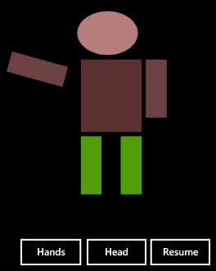
XAML Defining (Part 4: Your Animation Objects)
<Button Content="Resume" Height="72" HorizontalAlignment="Left" Margin="285,508,0,0" Name="button1" VerticalAlignment="Top" Width="134" Click="button1_Click" FontSize="18" />
<Button Content="Hands" Height="72" HorizontalAlignment="Left" Margin="48,508,0,0" Name="button2" VerticalAlignment="Top" Width="135" Click="button2_Click" FontSize="18" />
<Button Content="Head" Height="72" HorizontalAlignment="Right" Margin="0,508,154,0" Name="button3" VerticalAlignment="Top" Width="133" FontSize="18" Click="button3_Click" />
</Grid>
</Grid>
</phone:PhoneApplicationPage>

Slide 31
Code Behind the GUI: MainPage.xaml.cs (1)
namespace MyPhoneAnimation {
public partial class MainPage : PhoneApplicationPage {
DateTime startTime;
int resume = 1;
public MainPage() {
InitializeComponent();
startTime = DateTime.Now;
CompositionTarget.Rendering += OnCompositionTargetRendering;
headStoryboard.Begin();
}
void OnCompositionTargetRendering(object sender, EventArgs args) {
// Angle directly controlled rotation
rotate1.Angle = (rotate1.Angle + resume * 0.5) % 360;
// Time-controlled rotation
TimeSpan elapsedTime = DateTime.Now - startTime;
rotate2.Angle = resume * elapsedTime.TotalMinutes * 1000;
}

Slide 32
Code Behind the GUI: MainPage.xaml.cs (1)
private void button1_Click(object sender, RoutedEventArgs e) {
resume = -1; // Start to rotation in opposite direction
headStoryboard.Begin(); // Start head movement
}
private void button2_Click(object sender, RoutedEventArgs e) {
// Thread.Sleep(10000);
resume = 0; // arm rotations stop
}
private void button3_Click(object sender, RoutedEventArgs e) {
headStoryboard.Pause(); // head pause
}
}
}
How do you control the execution of the animation programmed in C#?
(A) Using Thread.Sleep(); (B) Using headStoryboard.Pause();
How do you manage the animation programmed in XAML Storyboard?
(A) Using Thread.Sleep(); (B) Using headStoryboard.Pause();

Slide 33
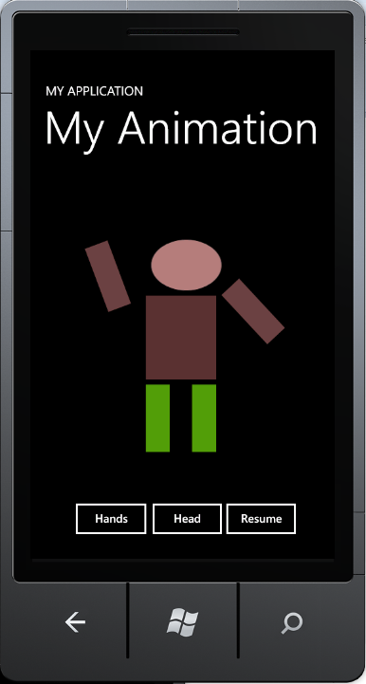
Demonstration

Slide 34
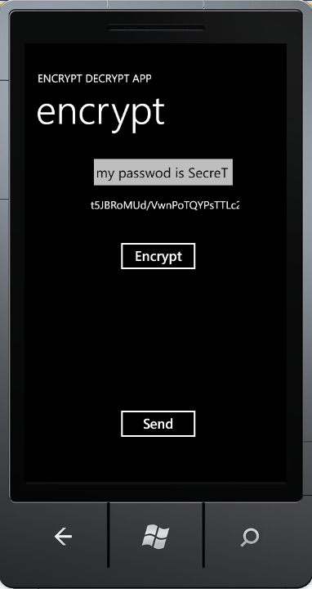
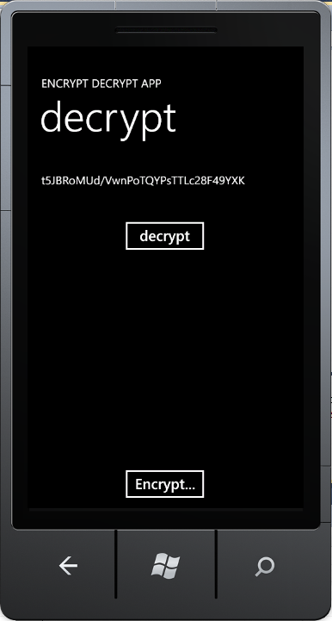
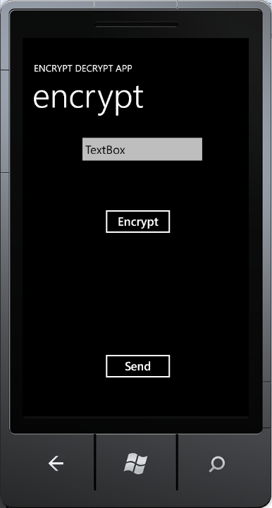

Case Study: Secure Phone Messenger
Phone apps rely on Web services to provide necessary functionalities;
Develop a secure phone messenger among friends an business partner

Slide 35
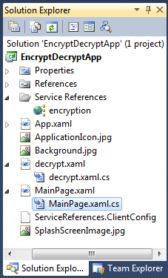
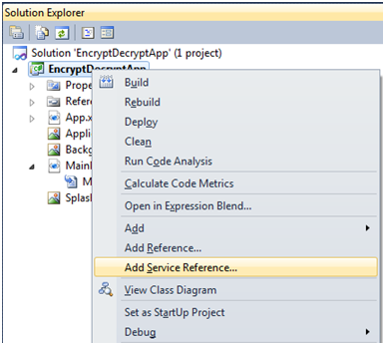
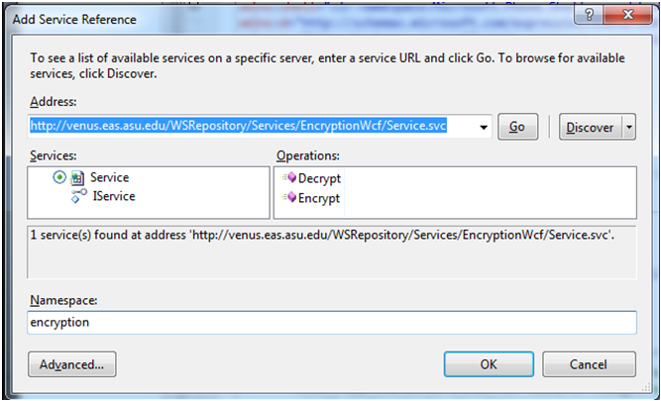
Add Encryption/Decryption Service

Slide 36

Code Behind GUI: MainPage.xaml.cs (1)
namespace EncryptDecryptApp {
public partial class MainPage : PhoneApplicationPage {
public string msgEncrypted;
public MainPage() // Constructor { InitializeComponent(); }
protected override void OnNavigatedTo(System.Windows.Navigation.NavigationEventArgs e) {
base.OnNavigatedTo(e); // try to receive msg from another page
string msg = "";
// Retrieve the string that is passed in the navigation URI
if (NavigationContext.QueryString.TryGetValue("msg", out msg))
textBlock1.Text = msg; // put the received data TextBox
}
// continued next page

Slide 37


Code Behind GUI: MainPage.xaml.cs (2)
// namespace EncryptDecryptApp {
private void Encrypt_Click(object sender, RoutedEventArgs e) {
string msg1 = textBox1.Text;
encryption.ServiceClient prxyEncrypt = new encryption.ServiceClient();
prxyEncrypt.EncryptCompleted += new EventHandler<EncryptCompletedEventArgs>(prxyEncrypt_EncryptAsync);
prxyEncrypt.EncryptAsync(msg1); // call encryption service
EventHandler<System.ComponentModel.AsyncCompletedEventArgs> (prxyEncrypt_CloseCompleted);
}
private void prxyEncrypt_EncryptAsync(object sender, EncryptCompletedEventArgs e) {
textBlock1.Text = e.Result;
}
private void send_Click(object sender, RoutedEventArgs e) {
this.NavigationService.Navigate(new Uri("/decrypt.xaml?msg=" + textBlock1.Text, UriKind.Relative));
} } }
Could be a global URI

Slide 38

Code Behind GUI: decrypt.xaml.cs (1)
namespace EncryptDecryptApp {
public partial class decrypt : PhoneApplicationPage {
public decrypt() { InitializeComponent(); }
protected override void OnNavigatedTo(System.Windows.Navigation.NavigationEventArgs e) {
base.OnNavigatedTo(e); // try to receive msg from another page
string msg = "";
// Retrieve the query string values that were passed in the navigation URI
if (NavigationContext.QueryString.TryGetValue("msg", out msg))
textBlock1.Text = msg; // put the received data TextBox
}

Slide 39


Code Behind GUI: decrypt.xaml.cs (1)
// namespace EncryptDecryptApp {
private void decrypt_Click(object sender, RoutedEventArgs e) {
string msgEncrypted = textBlock1.Text;
encryption.ServiceClient prxyEncrypt = new encryption.ServiceClient();
prxyEncrypt.DecryptCompleted += new EventHandler<DecryptCompletedEventArgs>(prxyEncrypt_DecryptAsync);
prxyEncrypt.DecryptAsync(msgEncrypted);
}
private void prxyEncrypt_DecryptAsync(object sender, DecryptCompletedEventArgs e) {
textBlock1.Text = e.Result;
}
private void Encrypt_Click(object sender, RoutedEventArgs e) {
string msg = "";
this.NavigationService.Navigate (new Uri("/MainPage.xaml?msg=" + msg, UriKind.Relative));
} } }
Could be a global URI

Slide 40
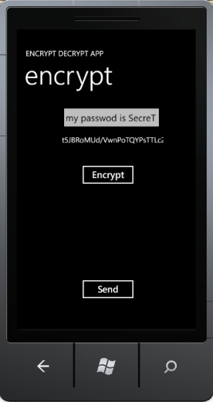
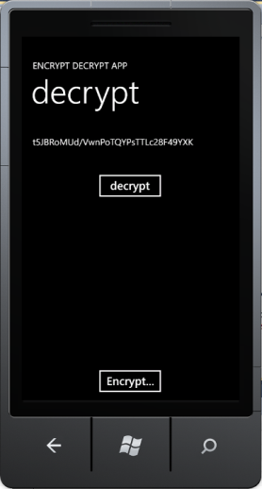
How Do We Send Message to Another Real Phone?
this.NavigationService.Navigate(new Uri("/MainPage.xaml?msg=" + msg, UriKind.Relative))
This RESTful service call transfer data to the REST service at the given URL;
The two pages are in the same solution and we can use local URL
Another real phone does not have a URL.
Message Queue Service
Take CSE446 or read text chapter 8 to learn message-based integration and asynchronous communication.

Slide 41
If SSL is not supported, then
Encryption Decryption Service
SSL is necessary
SSL is necessary
Clear text
Clear text
Encrypted text
Encrypted text
Message Queue Service
Encrypted text
Encrypted text stored
Encrypted text
SSL does not help

Slide 42
How are Confidentiality Guaranteed?
Built-in encryption/ decryption
Built-in encryption/ decryption
Message Queue Service
Encrypted text
Encrypted text stored
Encrypted text

Slide 43
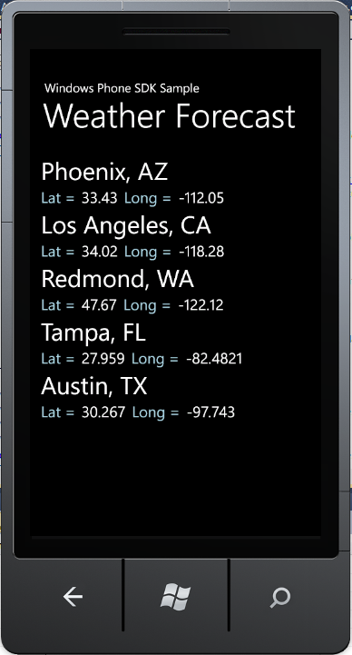
Case Study: Weather Forecast App
Microsoft Windows Phone Samples: http://go.microsoft.com/fwlink/?LinkID=219604
Download the Weather Forecast Sample:
This sample shows how you can call and process data from a web service in a Windows Phone application.
The sample uses the RESTful service call HttpWebRequest class to make an asynchronous call to a web service that provides weather forecast services: 7-day forecast data downloadable in the format of http://forecast.weather.gov/MapClick.php?lat=33.43417&lon=-112.05111&FcstType=dwml

Slide 44
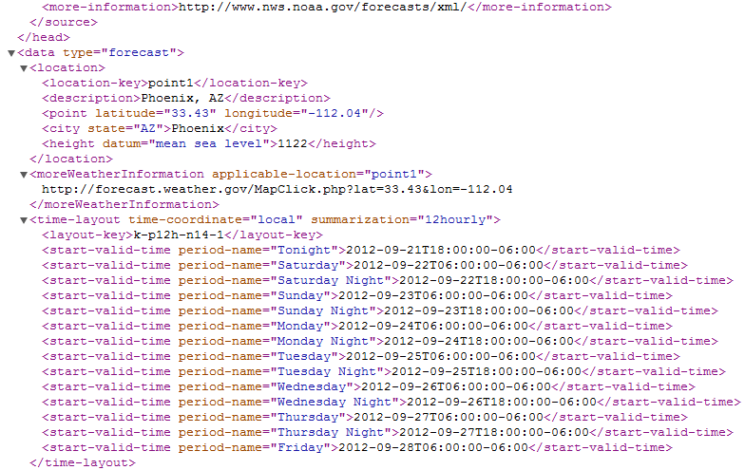
Phoenix Seven-Day Weather Data Download: http://forecast.weather.gov/MapClick.php?lat=33.43417&lon=-112.05111&FcstType=dwml

Slide 45
To Get Forecast from the URL http://forecast.weather.gov/MapClick.php?lat=33.43417&lon=-112.05111&FcstType=dwml
// The operation takes latitude and longitude as inputs, and obtain 7-day forecast
public void GetForecast(string latitude, string longitude) {
// form the URI
UriBuilder fullUri = new UriBuilder("http://forecast.weather.gov/MapClick.php");
fullUri.Query = "lat=" + latitude + "&lon=" + longitude + "&FcstType=dwml";
// initialize a new WebRequest: RESTful style service access
HttpWebRequest forecastRequest = (HttpWebRequest)WebRequest.Create(fullUri.Uri);
// set up the state object for the async request
ForecastUpdateState forecastState = new ForecastUpdateState();
forecastState.AsyncRequest = forecastRequest;
// start the asynchronous request
forecastRequest.BeginGetResponse(
new AsyncCallback(HandleForecastResponse), forecastState);
}

Slide 46
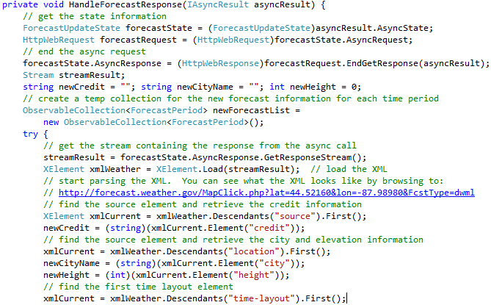
Process Forecast Response (XML File)
Read Text 10.4.5: LINQ to XML Processing

Slide 47
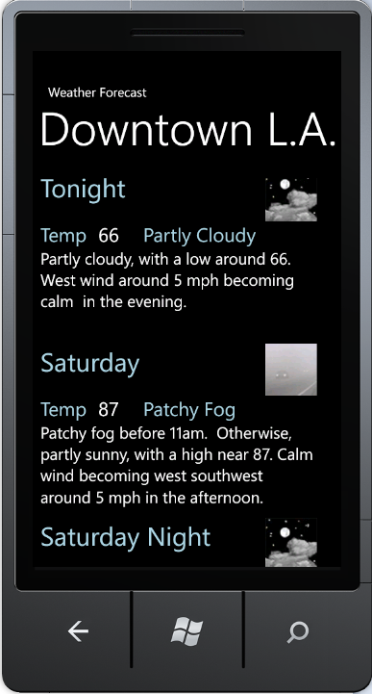
Extract and Display the Weather Info

Slide 48
More Examples
Developing a Robotics Application
Web Application
Phone Application

Slide 49
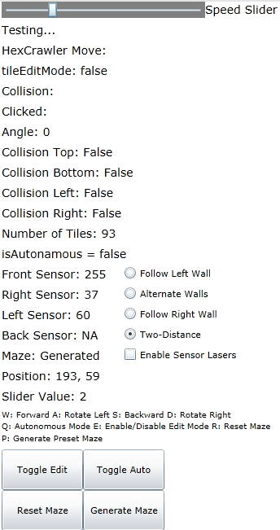
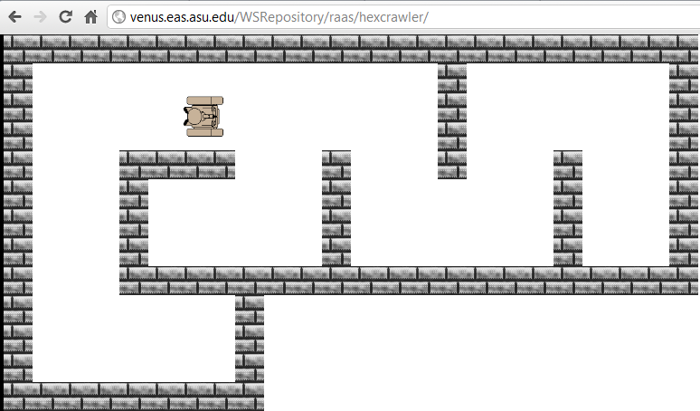
Silverlight Web App 1
http://venus.eas.asu.edu/WSRepository/raas/hexcrawler/

Slide 50
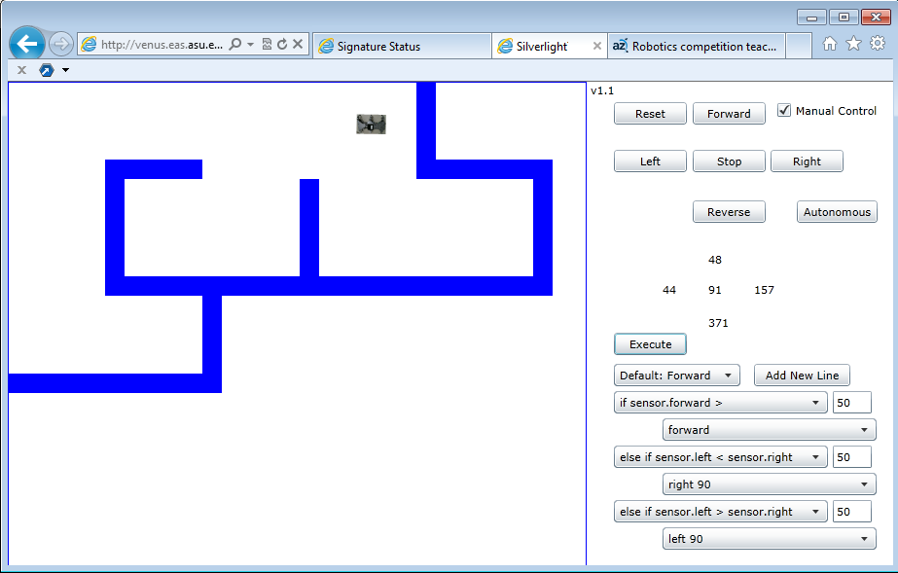
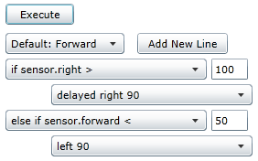
Silverlight Web App 2: With Programming Capacity
http://venus.eas.asu.edu/WSRepository/RaaS/MazeNav/
Farthest Difference Algorithm
Right-Wall-Following Algorithm

Slide 51
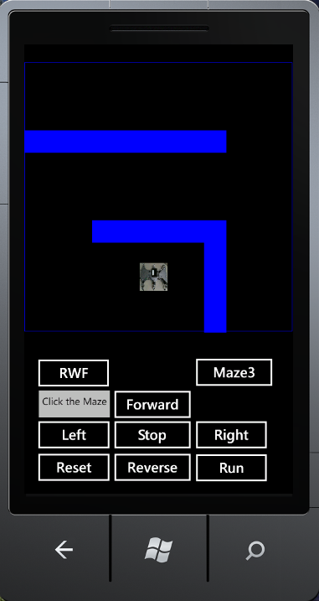
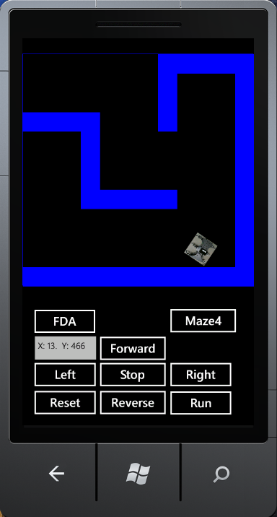
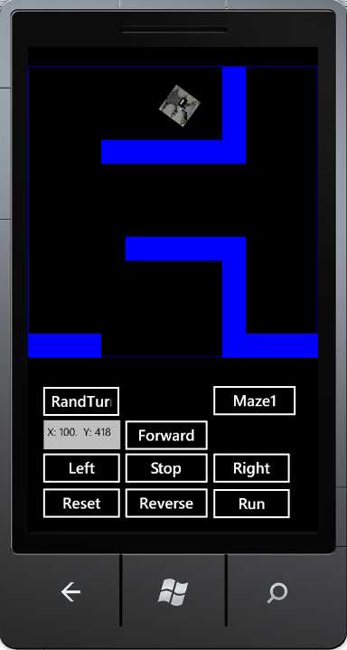
Phone App: Change Maze and Drive

Slide 52
MainPage.xaml Defines Phone GUI
<phone:PhoneApplicationPage
<Grid x:Name="LayoutRoot" Background="Transparent">
<Grid.RowDefinitions> <RowDefinition Height="Auto"/> <RowDefinition Height="*"/> </Grid.RowDefinitions>
<Grid x:Name="ContentPanel" Margin="12,37,12,0" ShowGridLines="True" Height="875" VerticalAlignment="Top" Grid.RowSpan="2">
<Button Content="Forward" Height="72" HorizontalAlignment="Left" Margin="125,533,0,0" Name="forwardButton" VerticalAlignment="Top" Width="160" Click="forwardButton_Click" />
<Button Content="Left" Height="72" HorizontalAlignment="Left" Margin="-5,590,0,0" Name="leftButton" VerticalAlignment="Top" Width="160" Click="leftButton_Click" />
<Button Content="Stop" Height="72" HorizontalAlignment="Left" Margin="125,590,0,0" Name="stopButton" VerticalAlignment="Top" Width="160" Click="stopButton_Click" />
<Button Content="Reverse" Height="72" HorizontalAlignment="Left" Margin="125,649,0,0" Name="reverseButton" VerticalAlignment="Top" Width="160" Click="reverseButton_Click" />
<CheckBox Content="CheckBox" Height="72" HorizontalAlignment="Left" Margin="285,522,0,0" Name="manualControlCheckBox" VerticalAlignment="Top" Checked="manualControlCheckBox_Click" />
<Button Content="Autonomous" Height="72" HorizontalAlignment="Left" Margin="265,649,0,0" Name="autonomousButton" VerticalAlignment="Top" Width="160" Click="autonomousButton_Click" />
<TextBox Height="72" HorizontalAlignment="Left" Margin="-5,643,0,0" Name="textBox1" Text="TextBox" VerticalAlignment="Top" Width="151" FontSize="18" />
<Button Content="Right" Height="72" HorizontalAlignment="Left" Margin="265,590,0,0" Name="rightButton" VerticalAlignment="Top" Width="160" Click="rightButton_Click" />
</Grid>
<!--TitlePanel contains the name of the application and page title-->
<StackPanel x:Name="TitlePanel" Grid.Row="0" Margin="12,17,0,28"></StackPanel>
<Canvas Height="560" HorizontalAlignment="Left" Name="canvas1" VerticalAlignment="Top" Width="480" Grid.RowSpan="2">
<Image Height="50" Name="theRobot" Stretch="Fill" Width="50" Source="/RobotSimulatorForWP;component/Images/Robot.jpg" Canvas.Left="121" Canvas.Top="357" />
</Canvas>
<!--ContentPanel - place additional content here-->
</Grid>
</phone:PhoneApplicationPage>

Slide 53
MainPage.xaml.cs Code Behind GUI: Buttons
private void forwardButton_Click(object sender, RoutedEventArgs e) {
manualControlCheckBox.IsChecked = true; autonomousActive = false;
move("forward");
}
private void leftButton_Click(object sender, RoutedEventArgs e) {
manualControlCheckBox.IsChecked = true; autonomousActive = false;
move("left");
}
private void rightButton_Click(object sender, RoutedEventArgs e) {
manualControlCheckBox.IsChecked = true; autonomousActive = false;
move("right");
}
private void reverseButton_Click(object sender, RoutedEventArgs e) {
manualControlCheckBox.IsChecked = true; autonomousActive = false;
move("reverse");
}
private void stopButton_Click(object sender, RoutedEventArgs e) {
manualControlCheckBox.IsChecked = true; autonomousActive = false;
move("stop");
}

Slide 54
MainPage.xaml.cs Code Behind GUI: move()
public void
(string direction) { // Configure the animation in Silverlight to do
// the correct action based on the motion received.
if (direction == "stop") {
CompositionTarget.Rendering -= updateFrame;
motion = direction;
}
else if (motion != direction) { // Check if not already going that same direction
if (motion != "stop") { // Check if already moving; It is moving; Stop moving
CompositionTarget.Rendering -= updateFrame;
motion = direction; // Move in the new direction.
CompositionTarget.Rendering += updateFrame;
}
else { // It is already stopped {
motion = direction; // Move right.
CompositionTarget.Rendering += updateFrame;
}
}
// Else: it is already moving the correct direction. Do nothing.
}

Slide 55
MainPage.xaml.cs Code Behind GUI: TurnLeft90
private void turnLeft90() {
double originalCompassReading = 400;
originalCompassReading = crossThreadSensorRead("compass");
double newDirection = originalCompassReading - 90;
if (newDirection < 0)
newDirection += 360;
crossThreadMoveCall("left");
double newReading = 400;
while (true) {
newReading = crossThreadSensorRead("compass");
if (newReading < 0)
newReading += 360;
if (differenceInAngles(newReading, newDirection) >= -2)
break;
}
crossThreadMoveCall("stop");
wantedAngle -= 90;
if (wantedAngle < 0)
wantedAngle += 360;
}

Slide 56
MainPage.xaml.cs Code Behind GUI: Key Down
private void KeyDownHandler(object sender, KeyEventArgs e) {
if (e.Key == Key.Up) {
if (manualControlCheckBox.IsChecked == false) {
manualControlCheckBox.IsChecked = true; setButtonEnables(); }
autonomousActive = false; move("forward");
}
else if (e.Key == Key.Left) {
if (manualControlCheckBox.IsChecked == false) {
manualControlCheckBox.IsChecked = true; setButtonEnables(); }
autonomousActive = false; move("left");
}
else if (e.Key == Key.Right) {
if (manualControlCheckBox.IsChecked == false) {
manualControlCheckBox.IsChecked = true; setButtonEnables(); }
autonomousActive = false; move("right");
}
else if (e.Key == Key.Down) {
if (manualControlCheckBox.IsChecked == false) {
manualControlCheckBox.IsChecked = true; setButtonEnables(); }
autonomousActive = false; move("reverse");
} }

Slide 57
MainPage.xaml.cs Code Behind GUI: Key Up
private void KeyUpHandler(object sender, KeyEventArgs e)
{
if (e.Key == Key.Up || e.Key == Key.Left || e.Key == Key.Down || e.Key == Key.Right)
{
if (manualControlCheckBox.IsChecked == false)
{
manualControlCheckBox.IsChecked = true;
setButtonEnables();
}
autonomousActive = false;
move("stop");
}
}

Slide 58
MainPage.xaml.cs Code Behind GUI: Mouse Click
private void mouseDownClick_Handler(object sender, GestureEventArgs e) {
int mouseXPos = Convert.ToInt32(e.GetPosition(null).X);
int mouseYPos = Convert.ToInt32(e.GetPosition(null).Y);
// This is a WP fix. When clicking it is offset by +30 on the Y-axis.
mouseYPos -= 30;
// Make sure the mouse-click occurred inside the "playable" region.
if (mouseXPos < worldSize && mouseYPos < worldSize) {
// Deplaying info in textbox
textBox1.Text = "X: " + mouseXPos.ToString() + ". Y: " + mouseYPos.ToString();
// Determine what "block"/"square" the mouse is in
int blockX = (mouseXPos / blockSize);
int blockY = (mouseYPos / blockSize);
int blockXPos = blockX * blockSize;
int blockYPos = blockY * blockSize;
toggleBlockNumber(blockX, blockY);
}
}
Not all event handlers are given here.

Slide 59
Deploy Phone App to Real Device
Deployment for Testing (Preparation):
Connect your phone to your computer through USB;
Your phone should appear in Zune software, assuming that you have installed Zune software;
See next page for deployment
You may download Windows Phone Developer Tools RTW, instead of using Visual Studio
http://www.microsoft.com/en-us/download/details.aspx?id=13890
Commercial Deployment
You must register an account at Microsoft App Store.
Free for DreamSpark student, and otherwise $99/year
MS will make acceptance test before release your apps;
The profit will be shared between you and Apps Store;

Slide 60
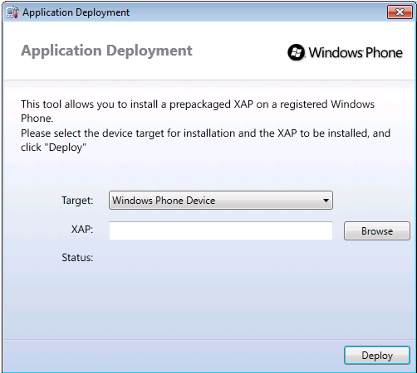

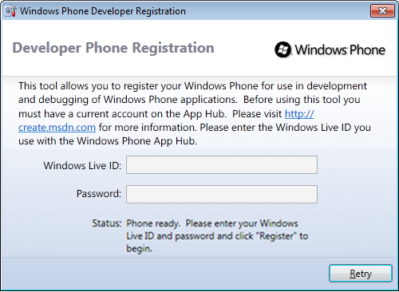
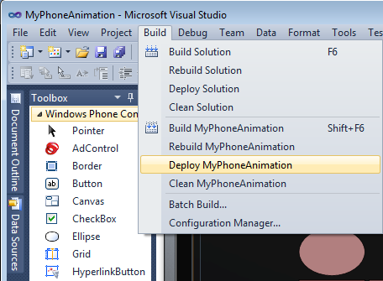
Register Your Phone and Link it in the Development Tool
Change Phone Emulator to Device
Start Menu Search

Slide 61
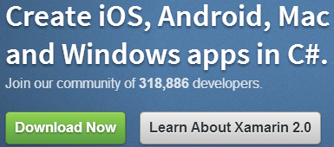
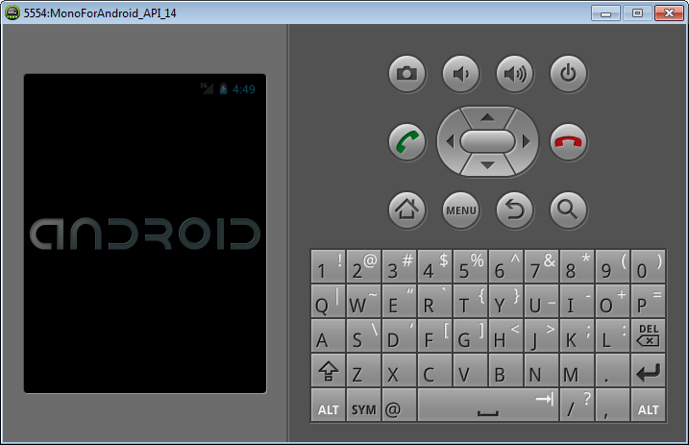

Develop Phone Apps on Other Platforms
You can download an other development SDKs to Visual Studio
develop C# phone apps on other platforms,
Android and
iPhone
For example: http://xamarin.com/

Slide 62
Lecture Summary
Silverlight Overview: Components and Controls
Getting Started with Hello Phone application
Creating Animations in Phone Apps
Using XAML
Using Code behind Page
Calling Web services in Phone Apps
Secure Messenger Using Encryption/Decryption Service
Weather Service Using National Weather Service
Complex Applications
Robotics Applications and GUI-based Programming

